Slide 1
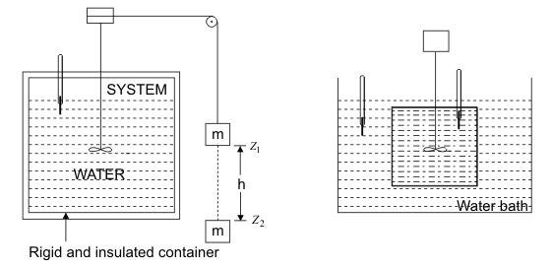
First Law of Thermodynamics
A series of Experiments carried out by Joule between 1843 and 1848 from the basis for the First Law of Thermodynamics

Slide 2

First Law of Thermodynamics
The following are the observations during the Paddle Wheel experiment shown in Fig.
Work done on the system by lowering the mass m through = change in PE of m
Temperature of the system was found to increase
System was brought into contact with a water bath
System was allowed to come back to initial state
Energy is transferred as heat from the system to the bath
The system thus executes a cycle which consists of work input to the system followed by the transfer of heat from the system.

Slide 3
First Law of Thermodynamics
Whenever a system undergoes a cyclic change, however complex the cycle may be, the algebraic sum of the work transfer is equal to the algebraic sum of the energy transfer as heat (FIRST LAW OF THERMODYNAMICS).
This law deals with the law of conservation of energy and the concept of internal energy
Work done by a system on its surroundings is treated as a positive quantity.
Energy transfer as heat to a system from its surroundings is treated as a positive quantity

Slide 4
Corollaries of First Law of Thermodynamics
Corollary 1 : For a Process
There exists a property of a closed system such that a change in its value is equal to the difference between heat supplied & the work done during the change of state.
Corollary 2 : The internal energy of a closed system remains unchanged if the system is isolated from its surroundings.
Corollary 3 : PMM-1
Perpetual motion machine of first kind which delivers work continuously without any input. The only interaction with the surrounding is the delivery of work. Which is impossible as its violates first law.

Slide 5
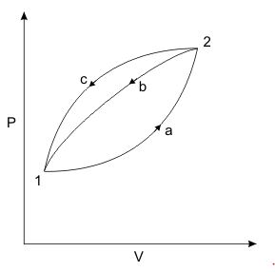



Let’s consider following two cycles: 1a2b1 and 1a2c1 and apply the first law of thermodynamics:
Subtracting Eq. second from Eq. first

Slide 6





Energy is a Property of the System
Refer to previous Figure again and consider Eq.
Then
depend on path function followed by the system. The quantity is the same for both the processes 2b1 and 2c1 connecting the states 2 and 1. The quantity does not depend on path followed by the system, depends on the initial and final states. Hence is an exact differential.

Slide 7
Differential of property of the system
This property is the internal energy of system, U
Energy of an Isolated System
An isolated system is one in which there is no interaction of the system with the surroundings. For an isolated system

Slide 8
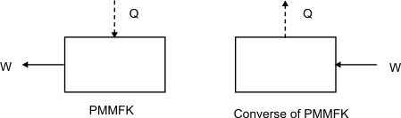
A Perpetual Motion Machine of First Kind
Thermodynamics originated as a result of man's endeavour to convert the disorganized form of energy (internal energy) into organized form of energy (work).
An imaginary device which would produce work continuously without absorbing any energy from its surroundings is called a Perpetual Motion Machine of the First kind, (PMMFK). A PMMFK is a device which violates the first law of thermodynamics. It is impossible to devise a PMMFK
The converse of the above statement is also true, i.e., there can be no machine which would continuously consume work without some other form of energy appearing simultaneously.

Slide 9
Limitations of First Law of Thermodynamics
The first law of thermodynamics is a law of conservation of energy. It does not specify the direction of the process. All spontaneous processes processed in one direction only. The first law of thermodynamics does not deny the feasibility of a process reversing itself. The first law of thermodynamics does not provide answers to the following questions.
IS A PARTICULAR PROCESS / REACTION FEASIBLE?
TO WHAT EXTENT DOES THE PROCESS / REACTION PROCEED?
IS COMPLETE CONVERSION OF INTERNAL ENERGY INTO WORK POSSIBLE?
There exists a law which determines the direction in which a spontaneous process proceeds. The law, known as the second law of thermodynamics, is a principle of wide generality and provides answer to the above questions.

Slide 10
Terms related 2nd Law
It is essential to understand the meaning of the following terms in order to discuss the second law of thermodynamics:
Thermal reservoir is a large body from which a finite quantity of energy can be extracted or to which a finite quantity of energy can be added as heat without changing its temperature.
A source is a thermal reservoir at high temperature from which a heat engine receives the energy as heat. It is also called as High Temp Reservoir. (HTR)
A sink is a low temperature thermal reservoir to which a heat engine rejects energy as heat. It is also called as Low Temp Reservoir.

